Slide 1




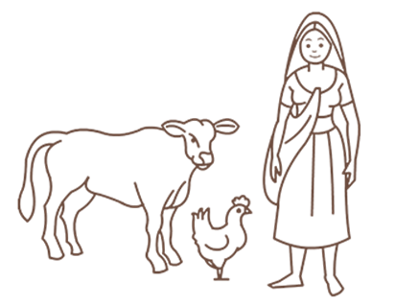

Ministry of Rural Development
DAY-NRLM
Session 2
INTRODUCTION TO LAKHPATI DIDIs

Slide 2

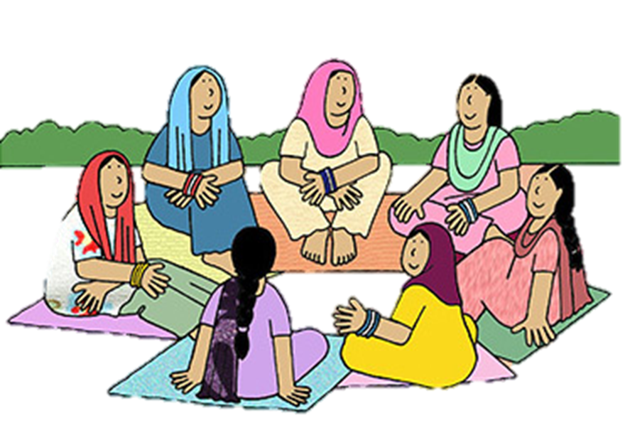
WHAT WILL WE DISCUSS?
1.Hon’ble PMs announcement
2.Who is a Lakhpati Didi
3.Survey Findings in 2022-23
4.Identification of Potential Lakhpati Didis
5.Roles and Activities of CRPs

Slide 3
Hon’ble Prime Minister on the 77th Independence Day:
(15th August, 2023)
आज 10 करोड़ महिलाएं women self help में जुड़ी हुई हैं और women self help group के साथ आप गांव में जाएंगे तो आपको बैंक वाली दीदी मिलेगी, आपको आंगनबाड़ी वाली दीदी मिलेगी, आपको दवाई देने वाली दीदी मिलेगी और अब मेरा सपना है, 2 करोड़ लखपति दीदी बनाने का, गांव में 2 करोड़ लखपति दीदी।
Today 10 crore women are involved in women self-help groups and if you go to a village with women self-help groups, you will find bank didis, Anganwadi didis with and didis who distribute medicines. And now my dream is to create a base of 2 crore lakhpati didis in the villages.

Slide 4
Hon’ble Prime Minister on the 77th Independence Day:
(15th August, 2023)
आज 10 करोड़ महिलाएं women self help में जुड़ी हुई हैं और women self help group के साथ आप गांव में जाएंगे तो आपको बैंक वाली दीदी मिलेगी, आपको आंगनबाड़ी वाली दीदी मिलेगी, आपको दवाई देने वाली दीदी मिलेगी और अब मेरा सपना है, 2 करोड़ लखपति दीदी बनाने का, गांव में 2 करोड़ लखपति दीदी।
Today 10 crore women are involved in women self-help groups and if you go to a village with women self-help groups, you will find bank didis, Anganwadi didis with and didis who distribute medicines. And now my dream is to create a base of 2 crore lakhpati didis in the villages.

Slide 5




SHG Member with annual household income
more than 1 lakh
Lakhpati
Didi
Average Monthly Income of ₹10,000 or more sustained for
at least four Agricultural Seasons/Business cycles

Slide 6
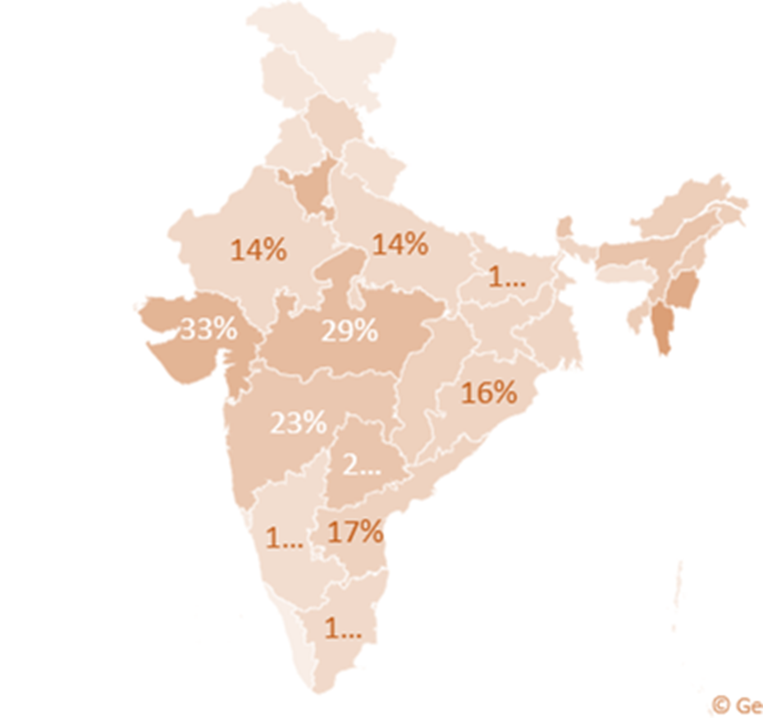
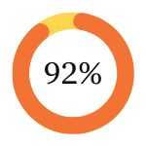
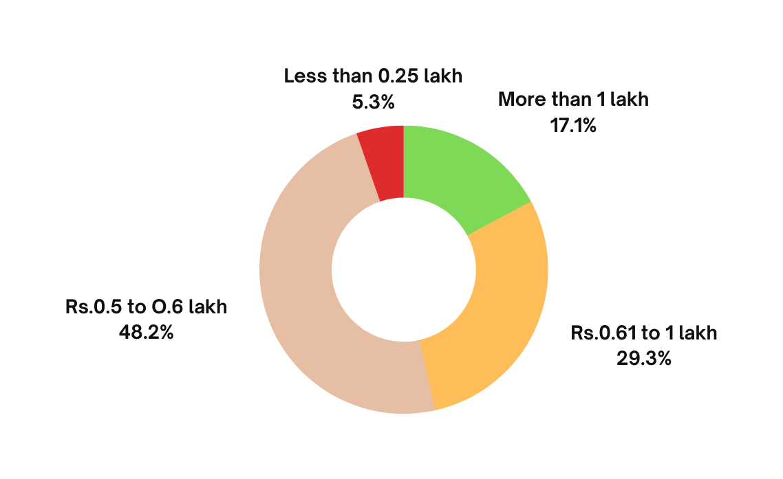
LAKHPATI SURVEY 2022-23
9 Crore SHG Households
8.34 Cr Surveyed
Lakhpati Didis

Slide 7

POTENTIAL LAKHPATI DIDI
CRITERIA
  SHGs who have completed minimum 2 years
  SHGs who have availed CIF
  SHGs who are the beneficiaries of livelihood intervention from DAY-NRLM
SUGGESTIONS
  Already Lakhpati Didi may also need handholding for some time, Max 25% of such Didis can be supported
  CRPs to be linked with each identified Lakhpati Didi who will be ensuring the transformation

Slide 8
HOW TO GET LIST OF POTENTIAL LAKHPATI DIDIS
Get the final List from BPM for the first phase of programme
  Contact BPM
  Obtain information pertaining to Name of HH, SHG, Year of Joining SHG, Current engagement in Livelihood activities and income from the activities can be seen in the excel sheet.
  Select the member in consultation with the CLF and VO Livelihood Sub Committee members following the criteria

Slide 9


CRP: ROLE AS PILLARS OF CONTINUOUS SUPPORT
Facilitator
Troubleshooter
Capacity Builder
Monitoring
Personalized guidance, Plan preparation tailored to each member and collation.
Connect with schemes, progs, institutions
Navigating through challenges
Data recording and reporting,
Continual oversight, course correction
Enhancing skills and knowledge of members

Slide 10





ACTION STEPS
  Orientation of the VO and CLFs on the Lakhpati Didi Programme as per the training plan given by BPM/CLF
  Conduct 2 days training of potential Lakhpati Didis and facilitate in preparation of Lakhpati Livelihood Plan
  Digitization of livelihood plan
  Collate the type of livelihood activities planned by SHG households and support the CLF/VO/ Block to prepare commodity/ product/ service clusters for support
  Collate demands around Assets, Skill Training, Finance and Market access and submit it to CLF and Block Mission unit for further facilitation.
  Handhold Lakhpati Didi while taking up livelihood activity
  Support in maintaining the Aajeevika register and update (bi-annually)
January
March
May
July
August
Write another activity, deadline or milestone here.
Write another activity, deadline or milestone here.
Write another activity, deadline or milestone here.
Write another activity, deadline or milestone here.
Write another activity, deadline or milestone here.

Slide 11



QUERIES &
OBSERVATIONS?

